Slide 1

Object Oriented Programing
Prepared By: Niranjan Bekoju

Slide 2
OOP Part I

Slide 3
Introduction
FROM PHP Version 5, we can also write php code in object oriented style.
It is faster and easier to execute.
OOP : Object Oriented Programming

Slide 4
Advantages
Faster and Easier to execute
Provides structure for the program.
Make php code DRY i.e. “Don’t Repeat itself”
Easier to maintain, modify and debug.
Code reusability
Shorter Development time

Slide 5
Class
Class is a template for objects
Or,
Class is a blueprint of an object
Object
Object is an instance of Class.
E.g: Real Estate Buildings

Slide 6
Constructor
Syntax: __construct()
It is the first method/function that runs during the creation of the object
Destructor
Syntax: __destruct()
It is an function called when object is destructed or the script is exited.

Slide 7
Visibility Model
Properties or attribute and Method or function can have access modifier:
Access modifier:
Public
Protected
Private
e.g: Dustbin location

Slide 8
OOP Part II

Slide 9
Inheritance
A class derives from another class
Child class will inherit all the public and protected property and method from parent class
It can also create own properties and methods
Extends keyword is used
class Child exteds Parent{
}

Slide 10
Types of Inheritance
Simple Inheritance
Multilevel Inheritance
Multiple Inheritance
Hierarchical Inheritance

Slide 11
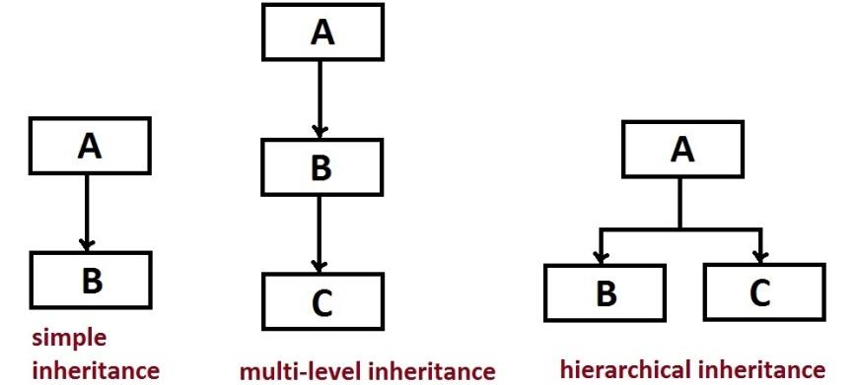
Inheritance in php

Slide 12
Abstract Keyword
Abstract Class is the class which cannot be instantiated.
It is used for the parent class.
Syntax:
abstract class Parent{
//your code goes here…
}

Slide 13
#Demonstration

